Slide 1
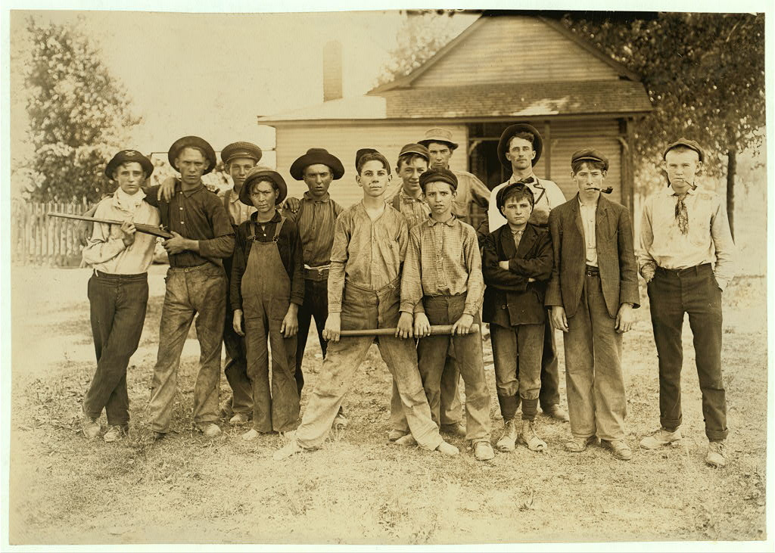
Teenage
Rebellion Never Gets Old

Slide 2
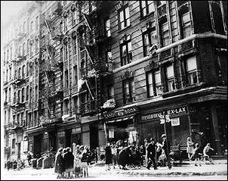
Hooligans 1875-1904

Slide 3
Hooligan
Merriam Webster defines it as
Thug; violent criminal, young ruffian
1890s Frederick Jackson Turner published “The Significance of the Frontier in American History” proclaiming that the wild frontier had come to a close.
Hooligans were attempting to become masters of their own destiny, ganging together in territorial disputes as a way of asserting themselves.

Slide 4
The Five Points Gang, led by Italian immigrant, Paolo Antonini Vaccarelli, also known as Paul Kelly and his second in command, Johnny Torrio, was the most significant street gang to form in the United States, ever. Johnny Torrio, who became a significant member of the Sicilian Mafia (La Cosa Nostra) recruited street hoodlums from across New York City to the Five Points Gang.
The Five Points Gang became the Major League to many young street gangsters and a farm club for the Mafia. The most notorious recruit into the Five Points Gang was a teenaged boy of Italian descent who was born in Williamsburg, Brooklyn in 1899 to immigrant parents.
His name was Alphonse Capone, better known as Scarface. He became a member of the James Street Gang, which was a minor league of sort, to the Five Pointers. One of Capone's childhood friends, and fellow member of the Five Points Gang, was another street thug named Lucky Luciano.

Slide 5
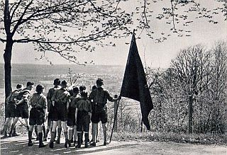
Wandervogel 1904-1913

Slide 6
Wandervogel
Wandervogel is the name adopted by a popular movement of German youth groups from 1896 onward. The name can be translated as rambling, hiking, or wandering bird and the ethos is to shake off the restrictions of society and get back to nature and freedom.
Blamed for being a ‘boys only club.’ By 1911 many groups agreed that young women should have an equal place in the movement. Disputes then took place about whether the genders should be kept separate.
The Wandervogel shared aims and means with the Boy Scouts – the love of the outdoors, the promise of peer bonding – but in the lack of any leadership imposed from above by adults, the youth of Germany chose to police themselves.

Slide 7
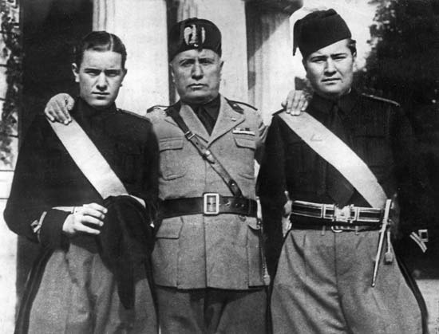
The Fascisti 1919-1929

Slide 8
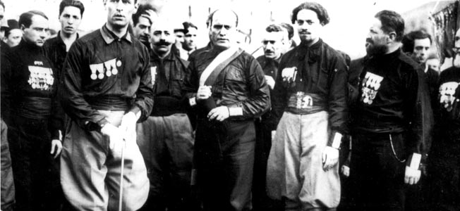
The Fascisti
Formed in the spring of 1919 the new party in Italy aimed to focus the anger of the returning veterans into a mass political party
The futurist insistence on the vitality of youth became the central part of the Fascist programme started by Benito Mussolini.
Rally Song: “Giovinezza! Giovinezza! (Youth! Youth!)

Slide 9
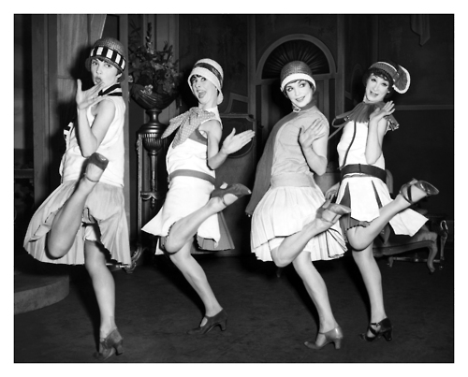
Flappers (Sheiks and Shebas) 1919-1929

Slide 10
Flappers (Sheiks and Shebas)
The term flapper had first appeared in Europe during the 1890s, meaning young prostitute. Just before WW1 Germans described (Backfisch) as an adolescent girl with boyish figure. Britain later redefined it as an independent, pleasure-seeking young women.
In 1920, Hollywood produced The Flapper, becoming the object of obsession and fashion.

Slide 11
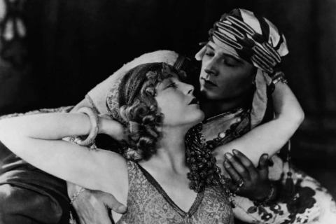
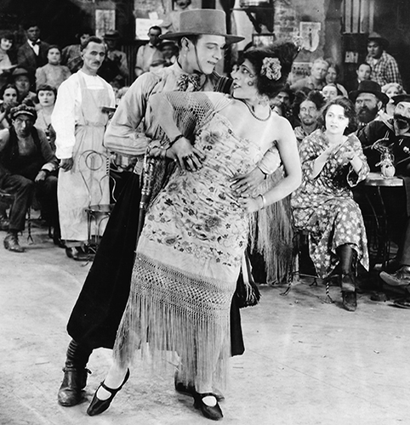
Flappers (Sheiks and Shebas)
In 1921 The Skeik, a torrid tale of a tabooed love affair between an English noblewomen and a sadistic Arab was released along with The Four Horsemen of the Apocalypse offering a new, completely un-American masculinity.
Youth were caught between exploitation and condemnation, between pleasure and puritanism, the 1920s generation were early victims of their country’s contradictory attitudes.

Slide 12
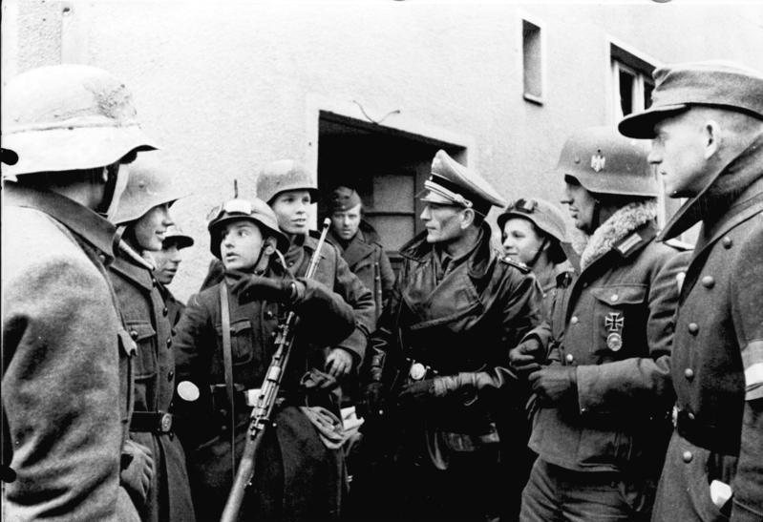
Hitler Youth 1930-1939

Slide 13
Hitler Youth
The 1920s generation had been seen as cynical, pleasure-driven, and materialist. Those coming of age during the 1930s were mobilized by one overwhelming agenda: to overturn capitalism.
Hitler Youth attracted German impoverished middle class youth. Combining xenophobia and racial mysticism with the hypnotic power of mass media, Adolf Hitler began his campaign to capture Germany’s younger generation.

Slide 14
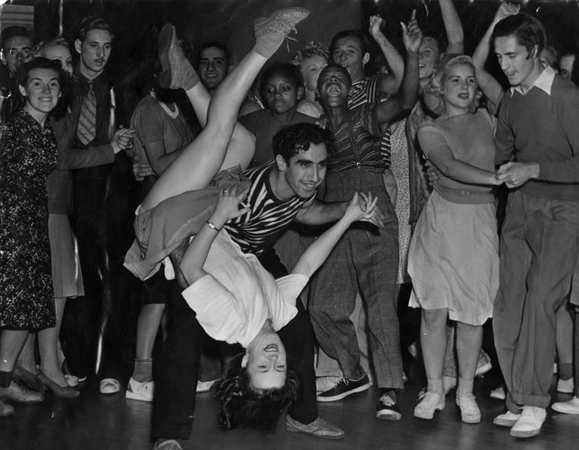
Jitterbugs

Slide 15
Jitterbugs
The popularity of swing was stimulated by radio. With swing, the tempo of life sped up and ushered in a new adolescent world with its own slang, magazines, fashions, and heroes. Rejecting the twenties model of strict rhythm dancing, this generation replaced grace and flow with raw spasmodic energy.
Youth and bands were more likely to be racially mixed.

Slide 16
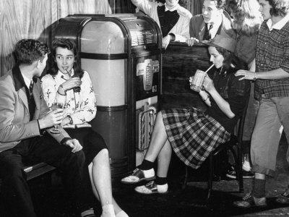
Sub-Debs 1939-1943

Slide 17
Sub-Debs
The American education shaped this youth class. It created a mixture of age-group organization and social blending, seasoned with the country’s insistence on the striving for success: To be successful is to be loved, to be loved is to be successful.
The conformist adolescent culture was centered around cliques which assumed an overwhelming importance in life, so much so that group loyalties usually triumphed the conflicts the clique and family, school, and neighborhood.

Slide 18
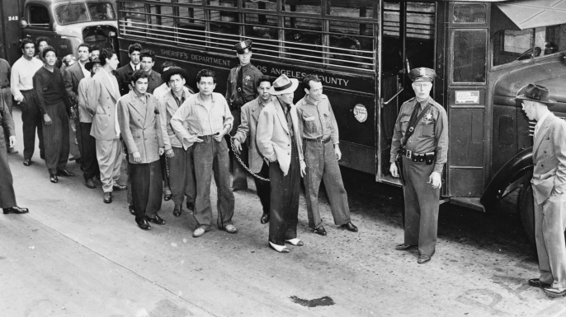
Zoot-Suiters

Slide 19
Zoot-Suiters
Zoot-suiters displayed their difference through their costume, but they were not outcast by choice. As recent immigrants, these young Mexican Americans recast the perennial second-generation problem in a new guise. Many of their parents had arrived in SoCal during the 1920s to work in the mines and on the farms, but the Depression had forced them to relocate into the inner urban areas of LA. Debarred from many jobs and most amenities, young Mexican Americans began to form neighborhood gangs in the late 1930s.
They were caught between their parents culture, where “a boy of sixteen was ready to assume responsibilities of family and a life in the community,” and American society, which sought to prolong adolescence. They rebelled against both cultures.

Slide 20
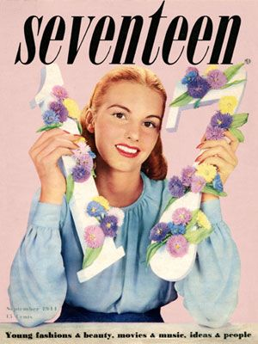
The First Issue of Seventeen
September 1944

Slide 21
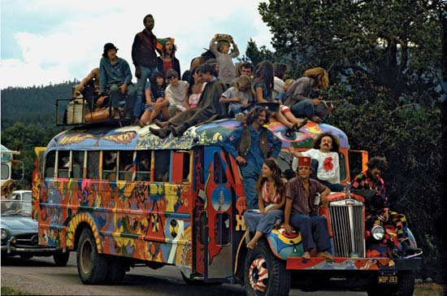
Hippies 1958-1970

Slide 22
Hippies
Is a member of a liberal counterculture, originally a youth movement that started in the United States and the United Kingdom during the mid-1960s and spread to other countries around the world. The word hippie came from hipster and was initially used to describe beatniks who had moved into New York City's Greenwich Village and San Francisco's Haight-Ashbury district.
The origins of the terms hip and hep are uncertain. By the 1940s, both had become part of African American jive slang and meant "sophisticated; currently fashionable; fully up-to-date”. The Beats adopted the term hip, and early hippies inherited the language and countercultural values of the Beat Generation. Hippies created their own communities, listened to psychedelic music, embraced the sexual revolution, and used drugs such as marijuana, LSD, peyote and psilocybin mushrooms to explore altered states of consciousness.

Slide 23
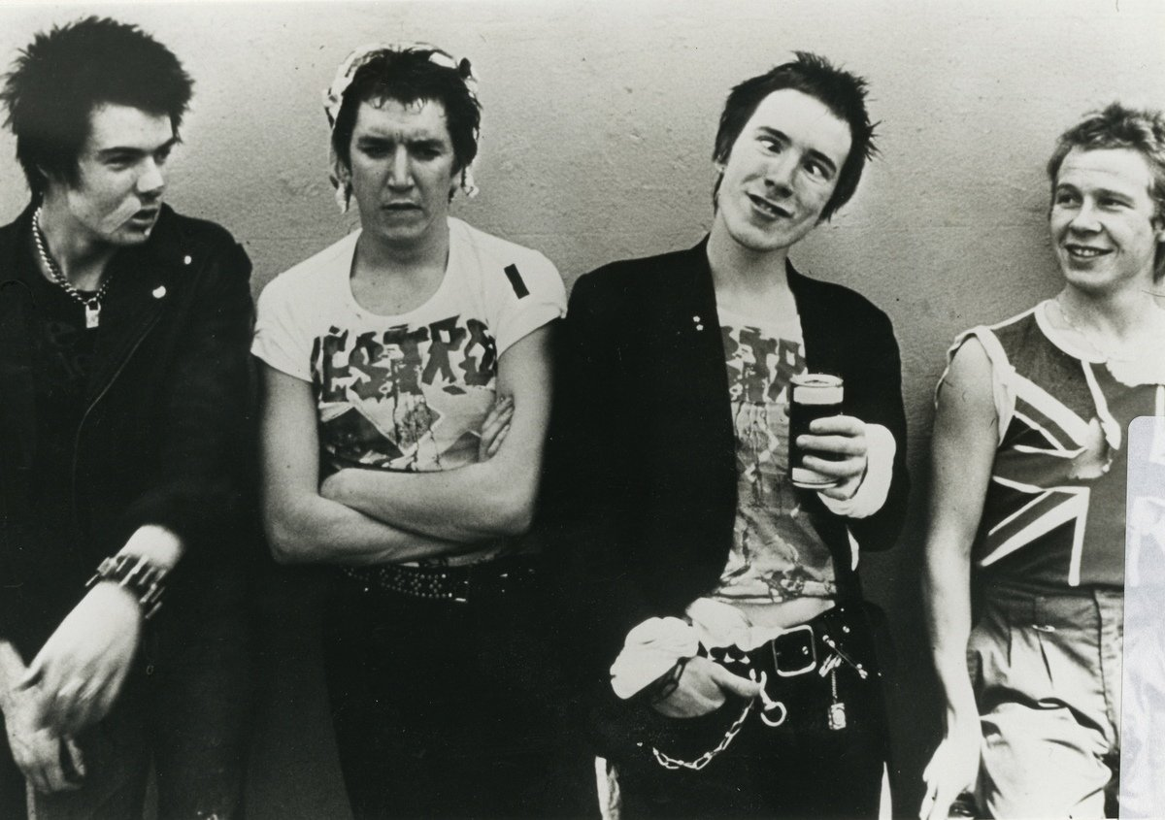
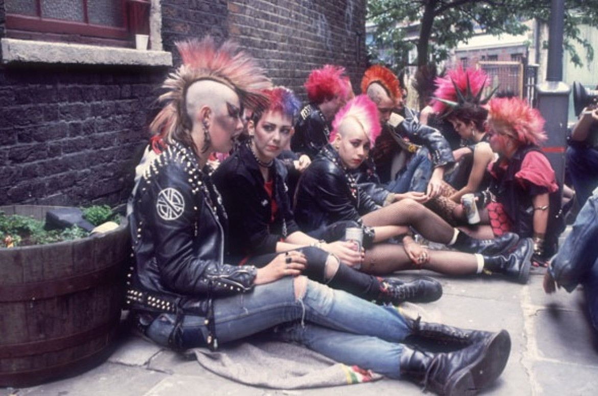
Punks 1970-1988

Slide 24
Punks
Punk is generally regarded as a defining moment in British cultural history. In its rhetoric and style, punk appeared to encapsulate the socio-economic and political climate of the late 1970s.
It seemed to form a distinct youth culture that in turn provoked a media-driven moral panic and prompted notable cultural change. Most significantly, punk appeared to politicize cultural practice at a significant juncture I
Its lyrics and iconography commented on society and politics; its approach challenged the prevailing orthodoxies of the music industry; it spawned a samizdat culture that served as an alternative media source of information and exchange; it questioned social and political hierarchies and notions of personal identity.in British history.

Slide 25
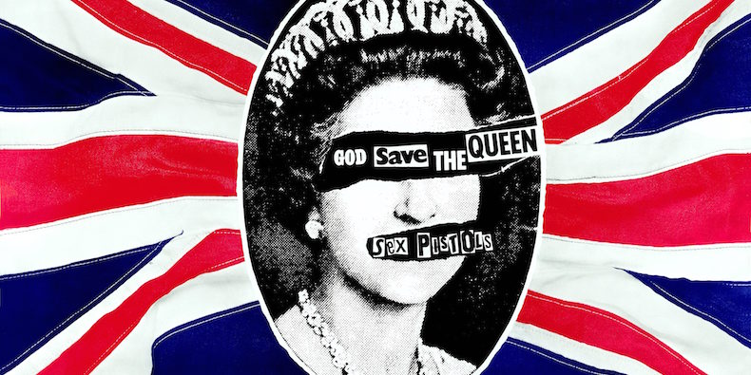
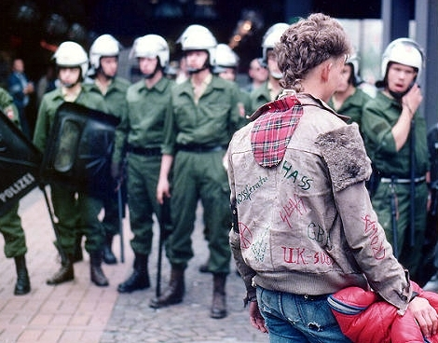
Messages from Punks
God Save the Queen:
https://www.youtube.com/watch?v=tN9EC3Gy6Nk
Boston Punks
https://vimeo.com/57412573

Slide 26
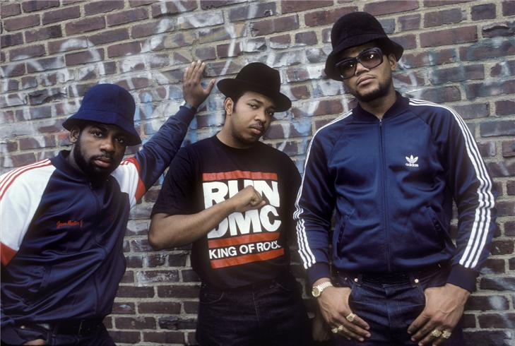
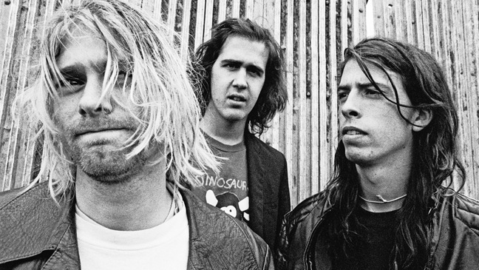
Three Cultures of the 1990s
Grunge
Hip-Hop
Preppy/Bobo (Post Yuppie)

Slide 27
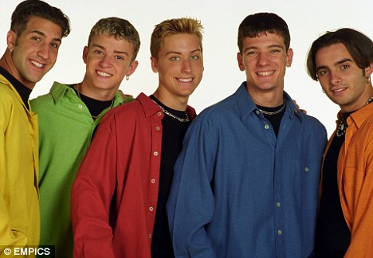
Preppy
New England preparatory schools, conservative protestant values and social stratification.
Artist included: New Kids on the Block, Backstreet Boys, NSYNC, Spice Girls, Boys II Men
Create a culture of exclusivity that had real influence
Blended with regular society
Worn, comfortable and vintage personality.
Approachable and less stuffy

Slide 28
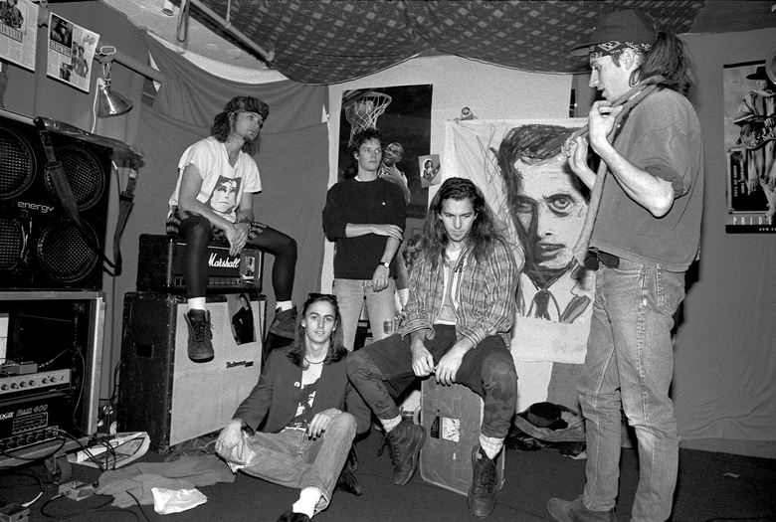
Grunge
Started in Seattle
Bands include: Nirvana, Pearl Jam, Soundgarden, Alice in Chains, Foo Fighters
Disenchanted with state of society
Often identified as slackers
Songs Deal with:
Social alienation
Apathy
Entrapment
Desire for freedom

Slide 29
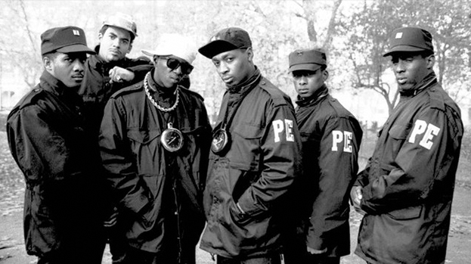
Hip-Hop
Hip-hop becomes mainstream in 90s.
Artist include: Run-DMC, Public Enemy, Beastie Boys, MC Hammer, Ice Cube, The Roots
Gangster Rap emerges early 90s
Reflection of inner-city life
Emphasis on violence, drugs, and weapons hurting the community

