Slide 1
Great Plains Homesteaders

Slide 2
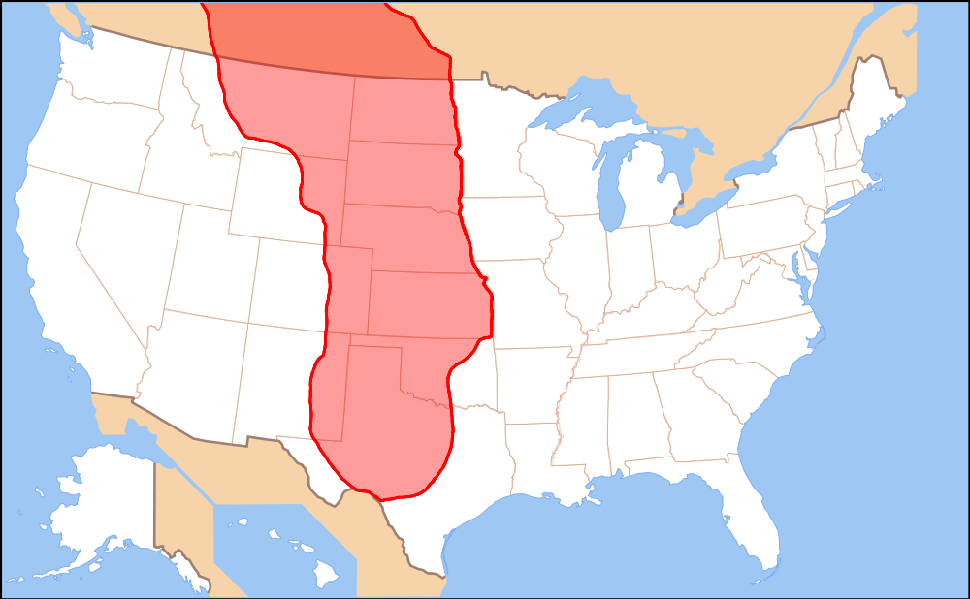
Great Plains
AKA “Great American Desert”
Notes:
Image retrieved from: https://en.wikipedia.org/wiki/Great_Plains#/media/File:Map_of_the_Great_Plains.png

Slide 3
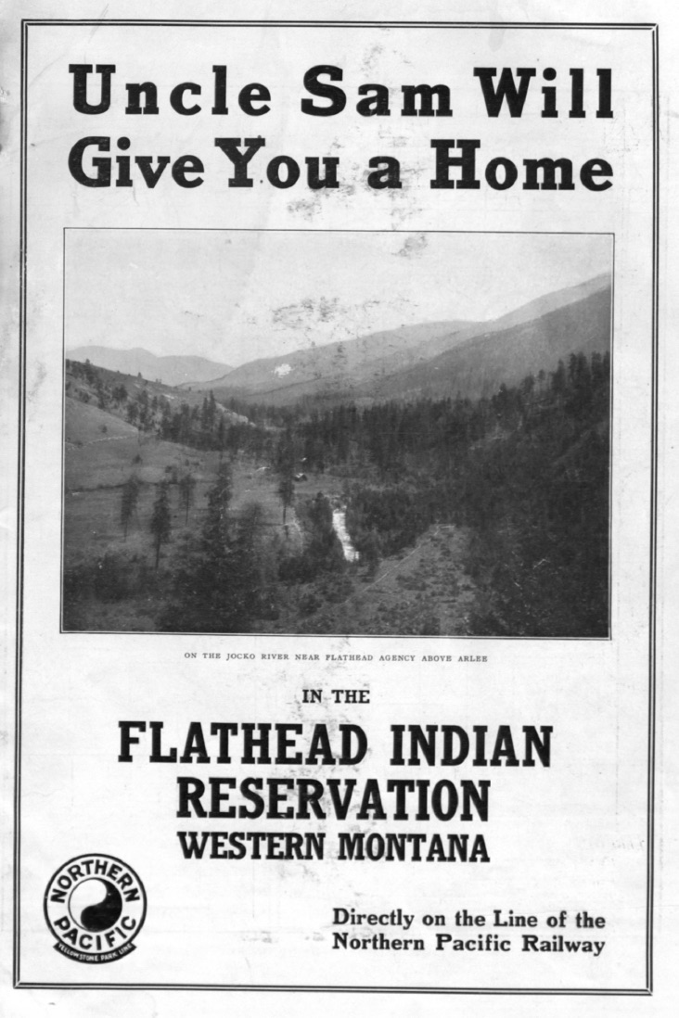
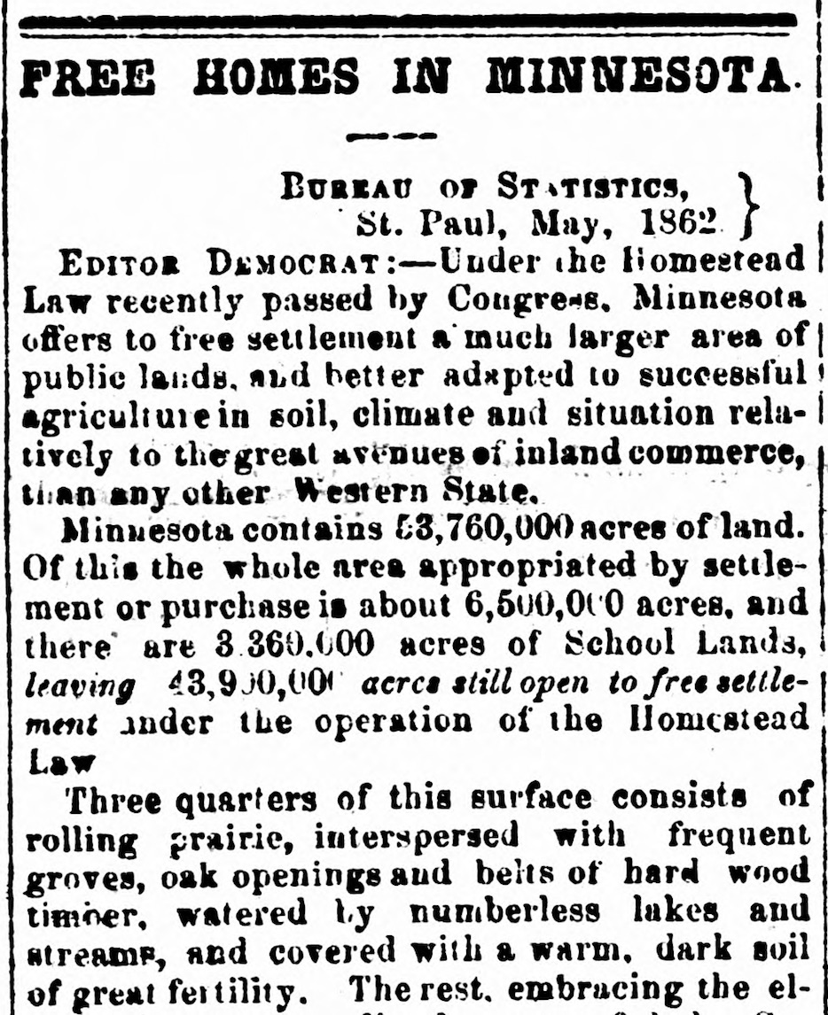
Homestead Act (1862)
1909 ad for land under the Homestead Act
1862 article in the St. Cloud Democrat
Notes:
Image on the left from the Digital Public Library of America: http://cdm16013.contentdm.oclc.org/cdm/ref/collection/p16013coll56/id/87
Image on the right retrieved from Chronicling America by the Library of Congress: https://chroniclingamerica.loc.gov/lccn/sn83016836/1862-06-19/ed-1/seq-1/#date1=1789&index=0&rows=20&searchType=advanced&language=&sequence=0&words=FREE+HOJSES+MINNESOTA&proxdistance=5&date2=1924&ortext=&proxtext=&phrasetext=FREE+HOJSES+IN+MINNESOTA&andtext=&dateFilterType=yearRange&page=1

Slide 4
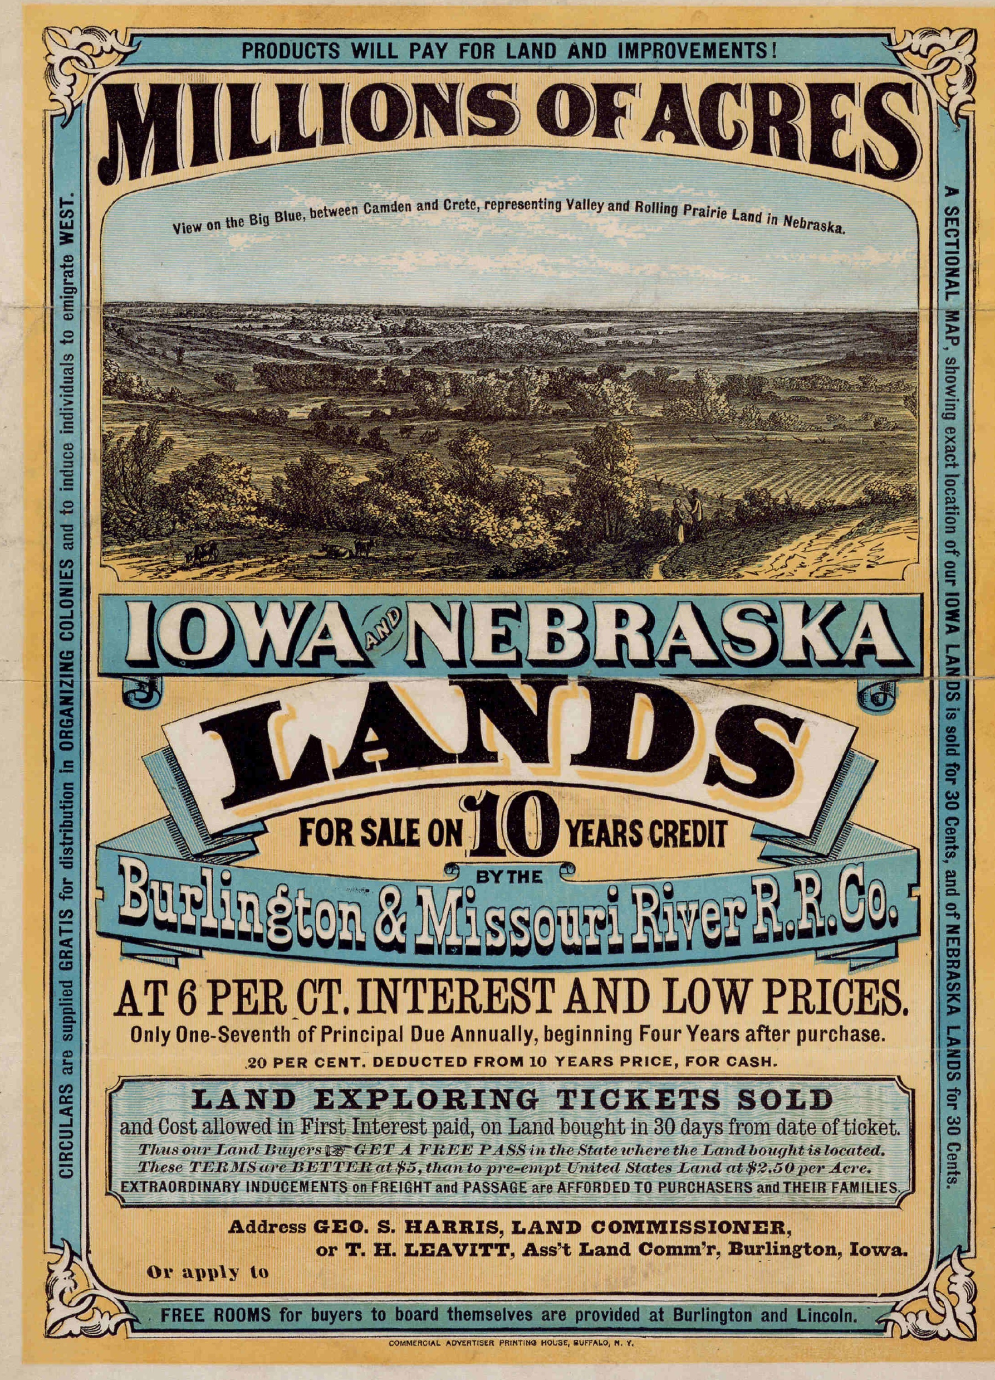
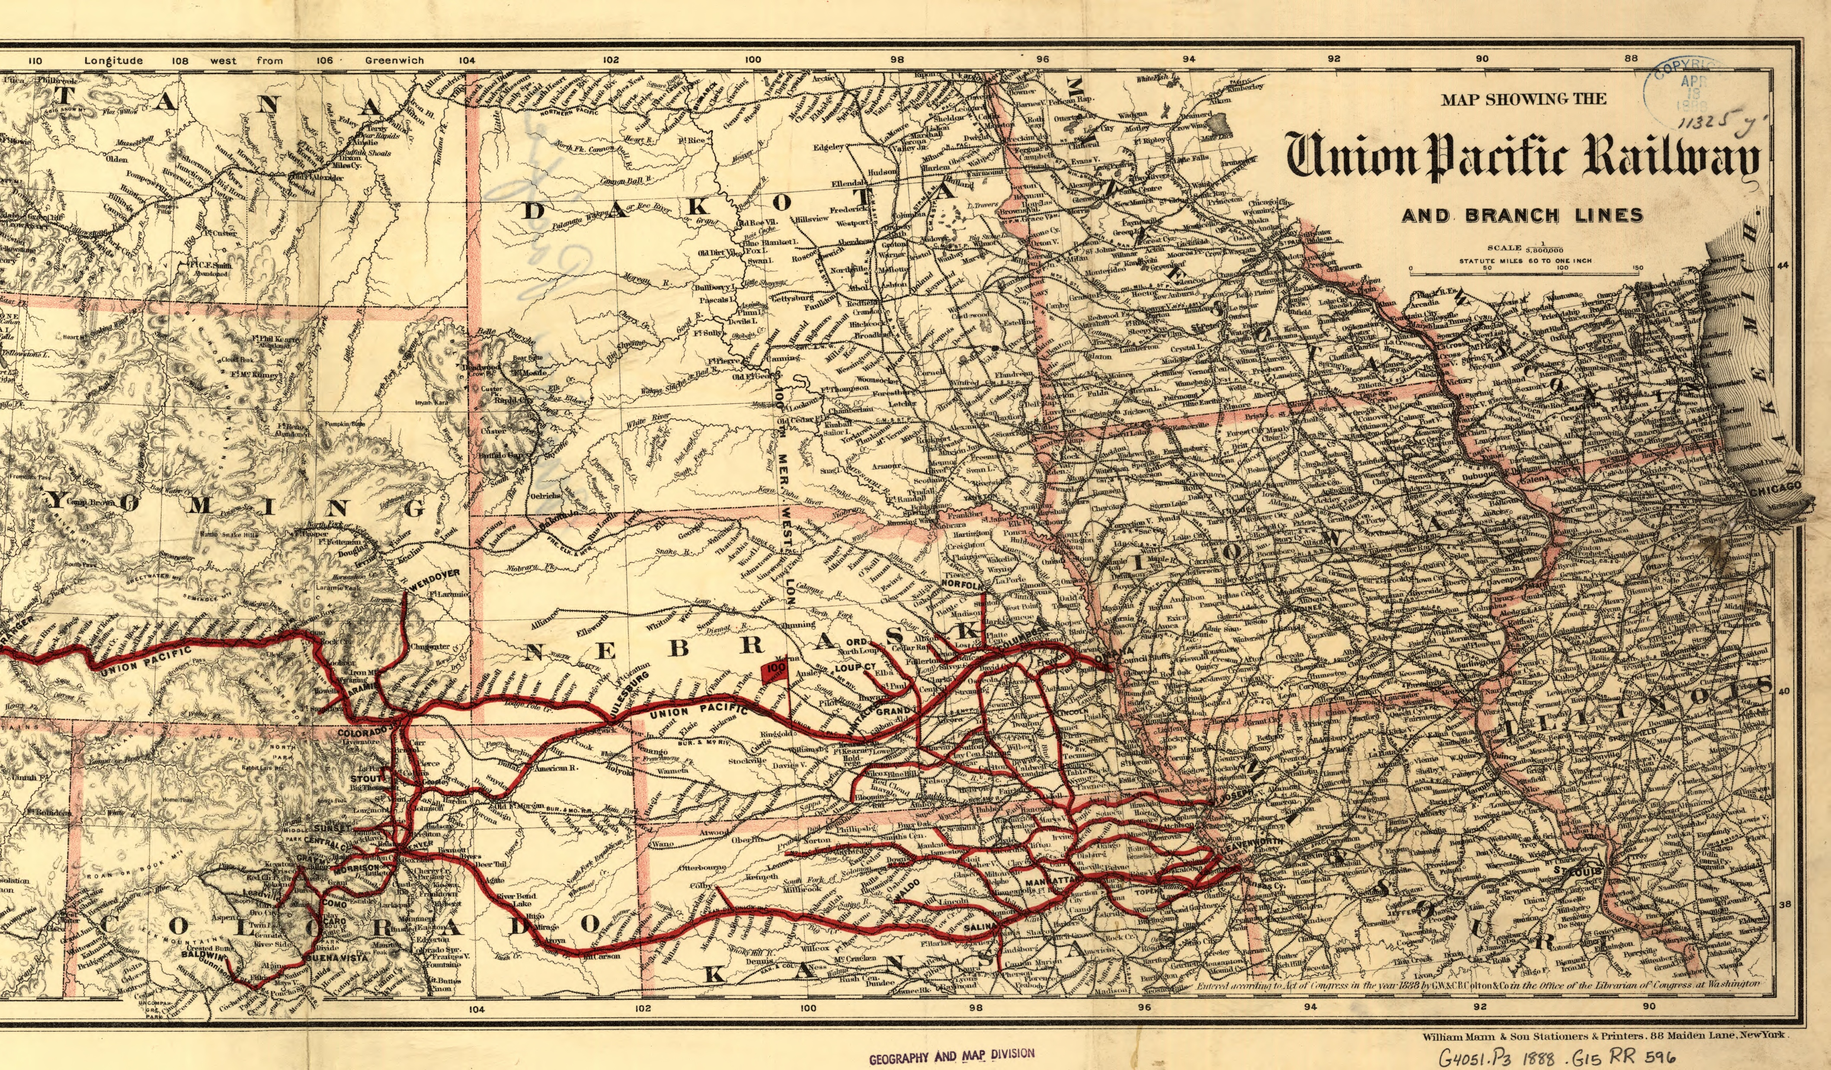
Pacific Railway Act (1862)
Map of Union Pacific rails in the Great Plains in 1888.
An 1872 advertisement from a railroad for inexpensive land for sale in Iowa and Nebraska in
Notes:
Images retrieved from the Library of Congress.
Left Image: www.loc.gov/resource/ppmsca.40755/
Burlington & Missouri River Railroad Co. Millions of acres. Iowa and Nebraska. Land for sale on 10 years credit by the Burlington & Missouri River R. R. Co. at 6 per ct interest and low prices ... Buffalo. N. Y. Commercial advertiser printing house. New York, 1872. Pdf. https://www.loc.gov/item/rbpe.13401300/.
Right Image: https://www.loc.gov/item/98688839/
G.W. & C.B. Colton & Co, and Union Pacific Railway Company. Map showing the Union Pacific Railway and branch lines. New York, 1888. Map. https://www.loc.gov/item/98688839/.

Slide 5
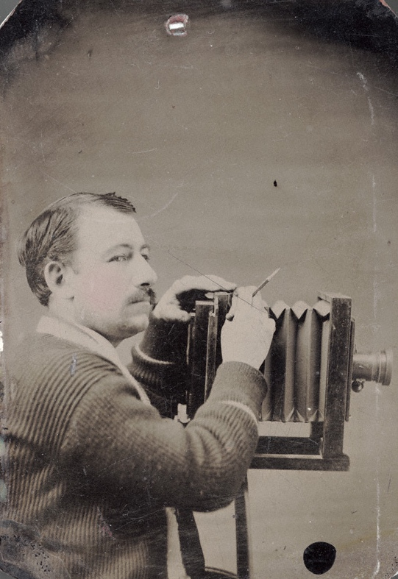
Solomon D. Butcher
Butcher in 1886
Custer County, Nebraska
Notes:
Image on the left retrieved from the Library of Congress and the Nebraska State Historical Society: https://memory.loc.gov/cgi-bin/query/r?ammem/psbib:@field(DOCID+@lit(p16311))
Images on the right retrieved from Wikimedia Commons:
https://commons.wikimedia.org/wiki/File:Map_of_USA_NE.svg
https://en.wikipedia.org/wiki/Custer_County,_Nebraska#/media/File:Map_of_Nebraska_highlighting_Custer_County.svg

Slide 6
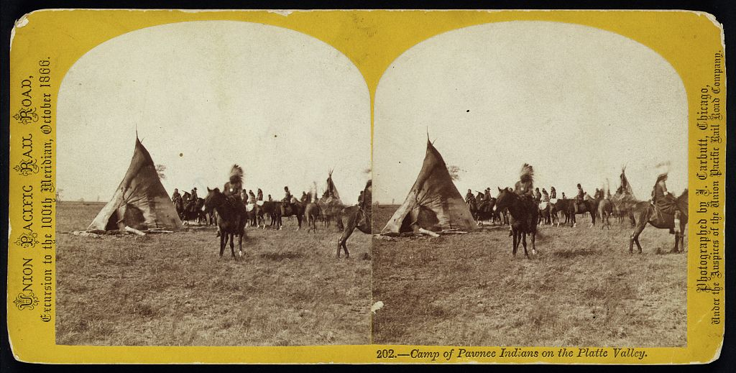
Displacement of the Pawnee
A Pawnee encampment in 1866
Notes:
Image retrieved from the Library of Congress: https://www.loc.gov/item/2005675917/
Carbutt, John, photographer. Camp of Pawnee Indians on the Platte Valley, 1866. Oct. Photograph. https://www.loc.gov/item/2005675917/.

Slide 7
Central Historical Question
What can Solomon Butcher’s photographs tell us about life for homesteaders on the Great Plains in the 1880s?

