Slide 1
US Supreme Court
A System of Checks and Balances

Slide 2
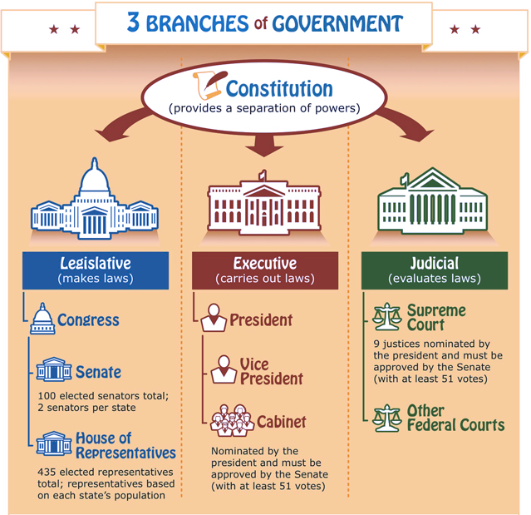

Slide 3
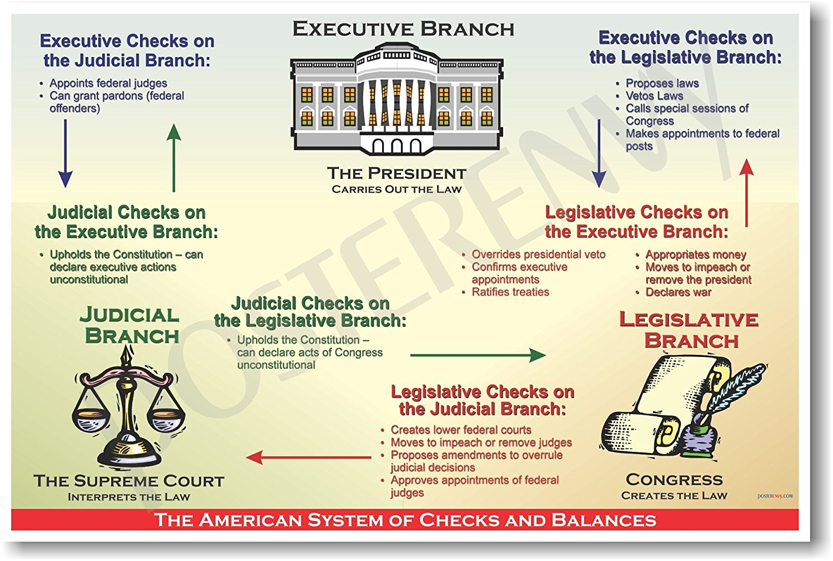

Slide 4
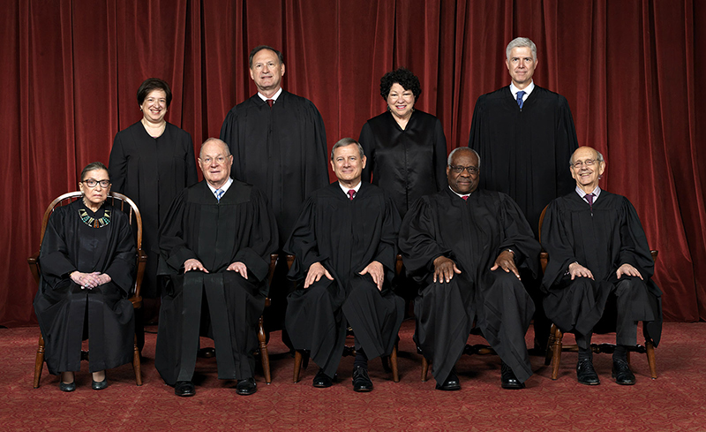
Elena Kagan
Samuel A. Alito
Sonia Sotomayor
Neil M. Gorsuch
67
50
63
57
81
62
69
84
79
Ruth Bader Ginsburg
Justice Anthony M. Kennedy
Chief Justice John G. Roberts, Jr.
Clarence Thomas
Stephen G. Breyer

