Slide 1
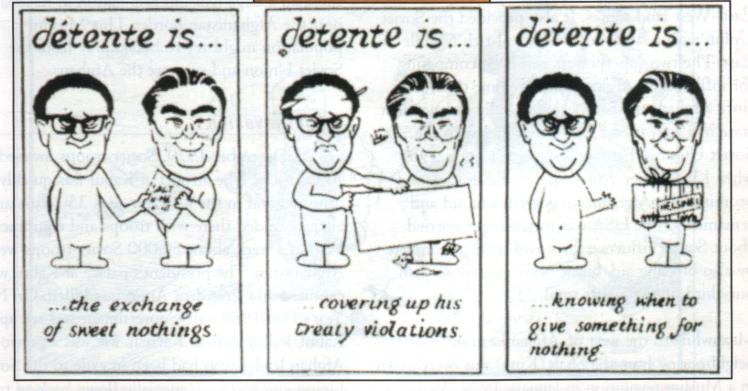
Detente- Success or Failure?
British cartoon, published 1976. How sincere does the artist think the two sides were in wanting to improve relations?

Slide 2
How successful was the détente?
East-West relations in the late 60s and early 70s
Détente between US and China
SALT
Space
Helsinki Conference

Slide 3
Détente:
The easing of hostility or strained relations, especially between countries

Slide 4
East & West Germany: Ostpolitik
During 1960s, Willy Brandt Chancellor of West Germany formed closer ties with Communist East Germany
Ostpolitik (normalization of relations)
1972, East & West Germany formally recognised each other’s frontiers
Trade links
Why was it so important for East & West Germany to recognise each others frontiers?

Slide 5
Strategic Arms Limitation Talks (SALT)
1969, USA & USSR begin arms negotiations
1972, SALT 1 signed
Both sides to limit numbers of nuclear weapons & warheads
1979, Salt II, agreement reached though never came into effect
Why does the artist of this 1970s cartoon think the 2 sides engaged in talks so keenly?

Slide 6
Détente between US and China
‘Ping pong’ diplomacy, after visits by US and Chinese table tennis teams
1971, US accepted Communist China as representative at UN
1972, Nixon visited Chairman Mao in Peking
Trade talks
US and USSR concerned about growing power of China
China and USSR agreed over Vietnam, but quarreled over other issues
US worried about Communist alliance between USSR and China

Slide 7
Co-operation in space
July 1975, Apollo & Soyuz spacecraft docked in space & astronauts met together
Badge worn by astronauts during the space link-up. Some critics argued the event was little more than a publicity stunt. How far do you agree?

Slide 8
Helsinki Conference, August 1975
35 countries (including USA & USSR) signed Helsinki Agreement
West recognised frontiers of Eastern Europe & Soviet ‘sphere of influence’
Soviets agreed to buy US grain & export oil to West
Greater freedom for Western journalists & guarantees of basic human rights
21 days notice of military manoeuvres near frontiers

Slide 9
 Your task
Complete a table similar to the one below
 | Why the US supported this | Why the USSR supported this
Better co-operation between East and West Germany
Arms limitation Talks
Co-operation in space
Helsinki Agreement

